Slide 1
Design and Analysis of Scissor Lift Mechanism
Muhammad Faiq Nasir (201075)
Muhammad Waleed Tariq (201111)
Saud Mubashir (201147)
Submitted To:
Dr. Imran Shah

Slide 2
Problem Statement
The purpose of this project is to perform stress analysis and design optimization for a scissor lift mechanism used in the field of Mechanics of Machines.
Kinematic Analysis
Stress Analysis
Dimensional Optimization
Design Optimization
Computational Simulation
Objectives

Slide 3
Introduction
Scissor Lift Overview:
Lifting devices using scissor mechanisms
Selection criteria: lifting height, weight, and equipment
Layout Variations:
Different layouts based on cylinder arrangement
Cylinder arrangement affects platform movement
Research Focus:
Studies commonly address simulation software and lift component strength
Limited focus on cylinder arrangement and thrust force calculations

Slide 4
Main Components of Scissor Lift
Hydraulic Cylinder
Top platform
Scissor Arm
Base support frame
Support hinges
Rollers

Slide 5
Design Constraints
Kinematic Analysis
Stress Analysis
Thorough understanding and analysis of the kinematics of the scissor lift mechanism
Studying the motion, geometric relationships, and constraints within the mechanism
Ensuring proper functioning and desired performance
Performing stress analysis using principles from Mechanics of Materials
Analyzing internal stresses and forces on critical components
Ensuring strength and durability
Considering applied loads, material properties, and design constraints

Slide 6
Design Constraints
Statistics
Machine Design
Utilizing statistical concepts to incorporate a factor of safety (F.S) of 1.3 in the design
Ensuring scissor lift mechanism can withstand anticipated loads and operating conditions
Applying principles of machine design to develop an efficient and reliable scissor lift mechanism
Considering component selection, dimensioning, material choices, and system optimization
Meeting load capacity and factor of safety requirements

Slide 7
Design Constraints
Weight Consideration
Computational Tools and Simulations
The total weight of the scissor lift structure is a crucial consideration in the project. Participants are tasked with minimizing the weight while maintaining the structural integrity of the mechanism. Weight optimization helps enhance the efficiency, portability, and overall performance of the scissor lift.
Participants are expected to employ computational tools, such as finite element analysis (FEA) software, and perform simulations to validate the design and analyze stress distribution. These tools aid in optimizing the scissor lift mechanism and provide valuable insights into its behavior under various operating conditions.

Slide 8
CAD Modeling
Computer-Aided Design (CAD) software is used to create detailed models and drawings of the scissor lift mechanism. CAD models help visualize the design, assess clearances, and facilitate the generation of manufacturing drawings.

Slide 9
Design Constraints
Kinematic Analysis
Stress Analysis
Identification of Critical Components
Load Capacity
Factor of Safety
Weight Optimization

Slide 10
Kinematic Analysis
Hydraulic cylinder:
The hydraulic cylinder is mounted in an inclined position. The total load acting on the cylinder consists of:
Mass to be put on the lift = 500 kg.
Taking FOS = 1.5 for mass in pallet 3000 x 1.5 = 4500 kg
Mass of top frame= 460 kg
Mass of each scissor arm = 63.57 kg
Total mass of four Scissor arms = 254.308 kg
Mass of links of cylinder mounting = 8 kg
Mass of cylinder = 18kg
Total Mass = 5266.308 kg
Total load = 5266.308x 9.81 = 51662.48N

Slide 11
Kinematic Analysis
For a scissor lift Force required to lift the load is dependent on, Angle of link with horizontal Mounting of cylinder on the links The length of the link.
Formula used
Where W = Load to be lifted
S= a2 + L2-2aLcos α
S = Distance between end points of the cylinder L= length of Scissor arm= 4.2 m
α = angle of cylinder with horizontal
Now the maximum force will act on the cylinder. When the cylinder is in shut down position i.e., when the scissor links are closed.
For calculations, we will consider α=30⁰ Now substituting α= 30⁰,
F=51662.48 N
Selecting 70 mm bore diameter of the cylinder Area of the bore of the cylinder
A = (3.14×70²)/2=3848mm²
Pressure=(Force/Area) = (51662.48/3848×10⁶) = 134.2 bar

Slide 12
Forces on Beam
The force acting on the beam are:
a) The reaction offered by the base to the roller, RA resolved into 2 components.
b) The reaction offered by the intermediate pin, HB, VB.
The force due to (Payload + Platform weight) resolved into two components, along with the length of the arms and perpendicular to the length of the scissor arm.
Now Let,
Hy0 =Mass applied on the lift = 4500kg
B=Mass of the lift which the cylinder needs to lift = 766.308kg
Hyi=Total weight = 51662.48N
W= force per unit length of scissor arm =1/2×base×w Hyi = 51662.48N
Hyi/4= 12915.62N
12915.62 Cos (30⁰) = 11184.71N
12915.62 Sin (30⁰) = 6457.5N
Now 11184.71= (1/2) ×2100×W
W=10.65N/mm
Taking moment of Point A,
VB×2100 – [(11184.71×2100×2/3)]
Therefore,
VB = 7456.47N
VB + RA Cos (30⁰) – 11184.71=0
Putting value of VB from equation (1) in equation (2), we get, 7456.47+RAcos (30⁰) – 11184.71 = 0
Therefore RA = 4305.00N
RA Cos (30) = 3728.239N
RA Sin(30⁰) = 2152.5N

Slide 13
Forces on Beam
𝛴𝐹𝑥 = 0
RAsin (30⁰) + 6457.5=HB
Therefore, HB = 8610N
𝑴 𝝈
=
𝑰 𝒀
Where,
M = Maximum Bending moment on the link considered as a beam. Y = distance of the neutral axis from the farthest fiber = h/2.
σb = allowable bending stress = 𝑆𝑢𝑡 = 400/4 = 100 MPa
I=moment of inertia of beam = (BH3- bh³)/12 = 2363858.66mm4
Where,
b = inner width of the beam
h =inner depth of the beam
B = outer width of beam
H = outer depth of beam
Now the maximum bending moment is at the point of zero shear force.
And Maximum bending moment is given by= wl2 / 9(3)½
Bmax = (10.65) × (21002) / (9√3) = 3012902.38 N.mm
Substituting in (M/I) = (σb/Y)
Assume Y=b/2
h=2b
b=35.61mm
Selecting the standard reference value close to calculated value (35.61mm) as: b = 50mm ; so h=2(50)= 100mm

Slide 14
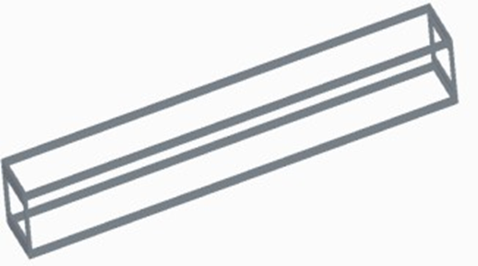
CAD Model
Creating a base platform:

Slide 15
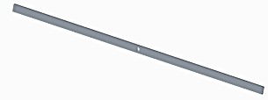
Modeling the scissor arms:

Slide 16

Create a lifting platform:

Slide 17

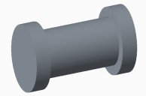

Adding actuators:

Slide 18
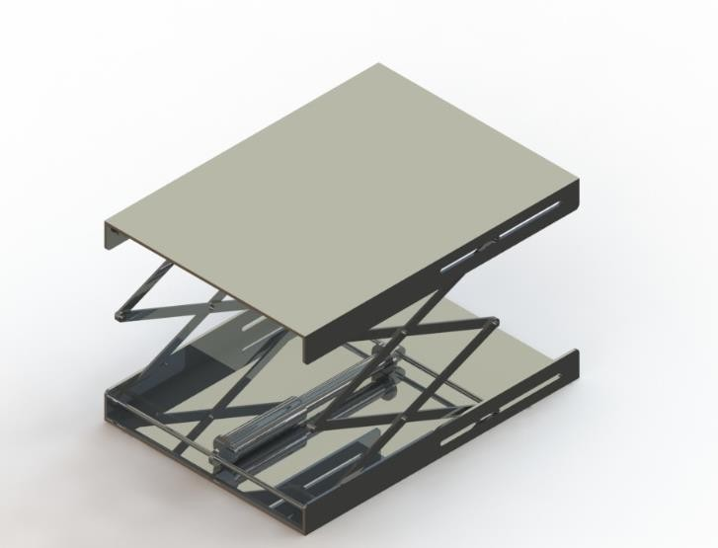
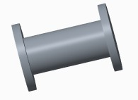
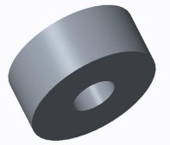

Slide 19
Finite Element Analysis – ANSYS
1. CAD Model Preparation:
Create detailed 3D CAD model in Solidworks
Include all components, joints, and connections
Save file in compatible format
Upload CAD file to ANSYS for analysis
2. Material Properties:
Assign material properties in ANSYS
Consider modulus of elasticity, Poisson's ratio, and yield strength
Select Mild Steel as the material for components

Slide 20
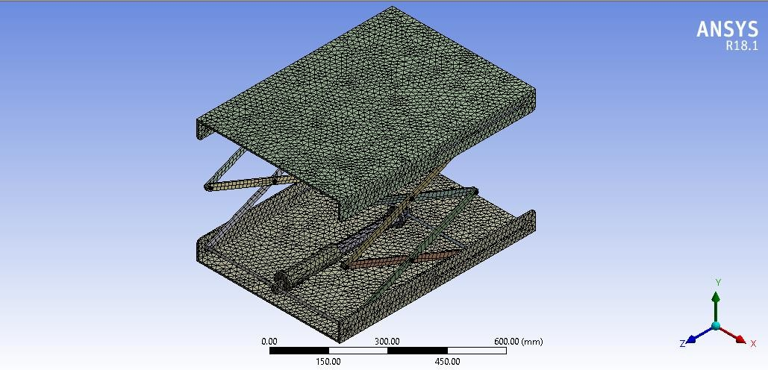
3. Mesh Generation:
Divide CAD model into finite elements in ANSYS
Choose element type (e.g., tetrahedral, hexahedral) based on geometry complexity
Determine element size for desired accuracy in the simulation

Slide 21
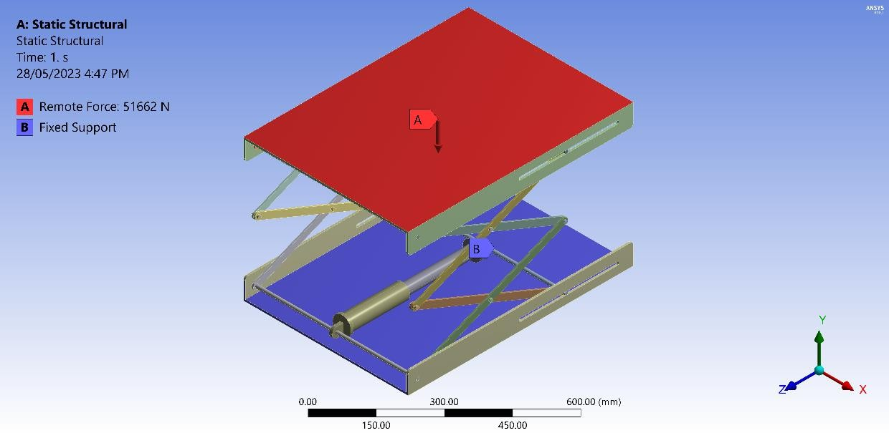
4. Boundary Conditions:
Define constraints in FEA software
Fix points or faces representing connections to ground or support
Apply remote force of 51662 on top of scissor lift mechanism
Implement fixed support boundary condition on bottom surface

Slide 22
5. Load Application:
Apply loads based on intended operating conditions
Consider weight of lifted load, dynamic forces, and external loads
Simulate realistic operating scenarios for accurate analysis
6. Analysis Setup:
Specify analysis type (static, dynamic, etc.)
Choose appropriate solution techniques in FEA software
Define solver settings and convergence criteria for accurate results

Slide 23
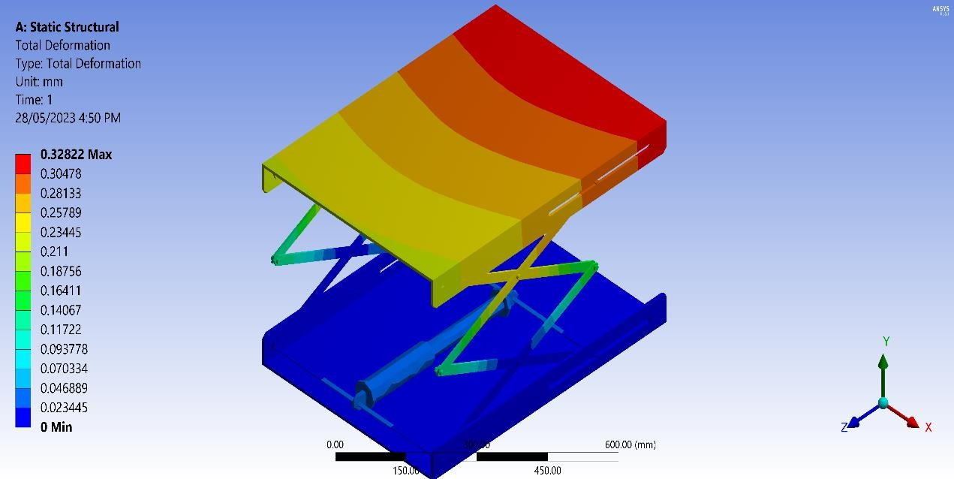
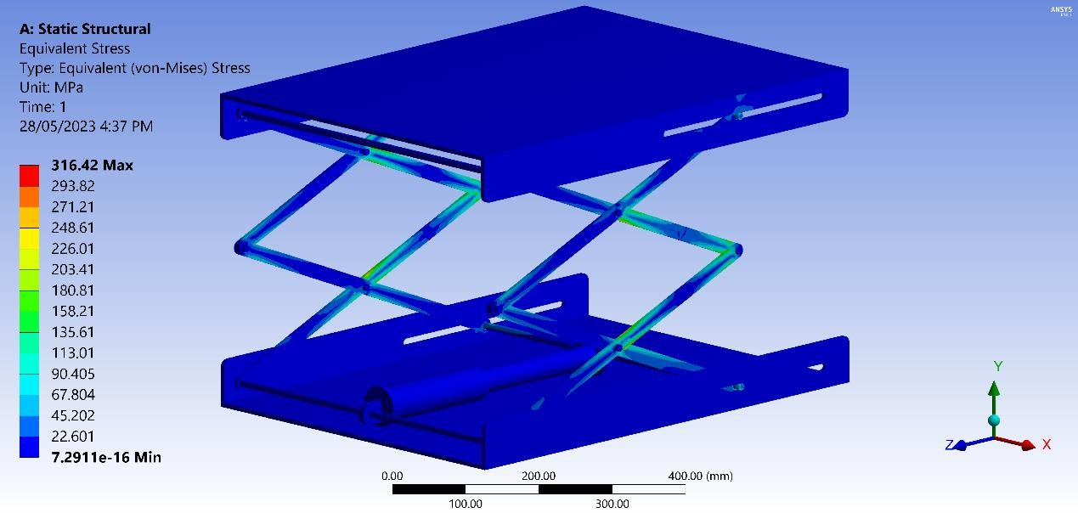
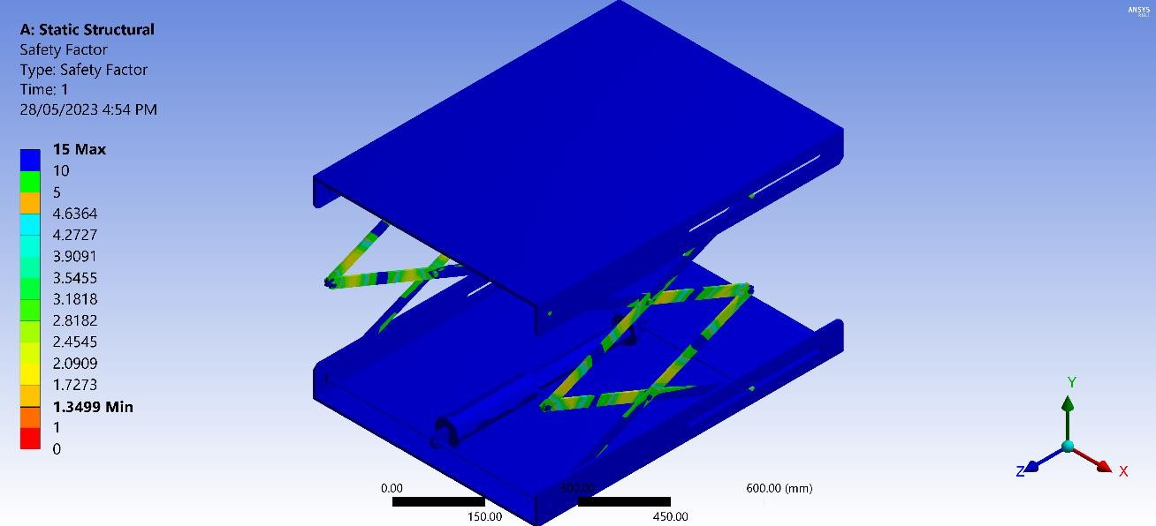
7. Solve and Analyze:

Slide 24
Evaluation of Software Results
1. Maximum Equivalent Stress
Value: 316.42 MPa
Represents highest stress under applied loads
Compare with material's yield strength for safety assessment
2. Total Deformation
Measurement: 0.32822 mm
Represents overall displacement/deformation under applied loads
Assesses potential interference issues due to deformation

Slide 25
3. Maximum Factor of Safety
Maximum FOS: 15
Indicates design's margin of safety
Higher value suggests robust and conservative design
FOS of 15 indicates the structure can withstand loads with a considerable safety margin.
4. Minimum Factor of Safety
Value: 1.399
Represents lowest observed FOS in any part of the structure
Ensure minimum FOS stays above 1 for design safety
Indicates structure can withstand loads without exceeding material's yield strength

Slide 26
Physical Applications
Automotive maintenance
Warehousing and logistics
Manufacturing industry
Loading docks
Aircraft maintenance
Exhibition and event setup
Hospital and healthcare
Retail and inventory management
Agriculture

Slide 27
References
[1]. M.Kiran Kumar, J.Chandrashekhar, Mahipal Manda, D.vijay Kumar (2016), Design & Analysis of Hydraulic Scissor Lift. IRJET Vol.3 page.1647.
[2]. Jaydeep M. Bhatt, Milan J. Pandya(2013), Design and Analysis of an Aerial Scissor Lift, Journal of information, knowledge and research in mechanical engineering,Vol.02 Page 452.
[3]. Georgy Olenin,(2016) Design of hydraulic scissor lifting platform, Saimaa University Of Applied Sciences Lappeenranta, Page no.13-14.
[4]. Gaffar G. Momin, Rohan Hatti, Karan Dalvi, Faisal Bargi, Rohit Devare,(2015), Design, Manufacturing & Analysis of Hydraulic Scissor Lift,IJERGS, Vol.3 Page 735-738

Slide 28
Thank you for your time 😊

